Slide 1
Algorithms
Mushtari Sadia

Slide 2
Topological Sorting

Slide 3
DAG -> Directed Acyclic Graph
A topological sort of a dag G = (V,E) is a linear ordering of all its vertices such that if G contains an edge (u,v) , then u appears before in the ordering. (If the graph contains a cycle, then no linear ordering is possible.)

Slide 4
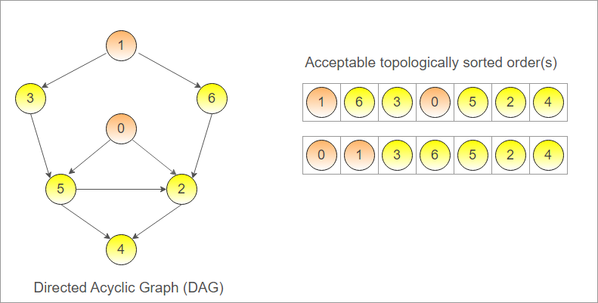
Topological Sort

Slide 5
Topological Sort
Unacceptable topologically sorted order:
1 6 3 2 5 0 4
As 0 should come before 2

Slide 6
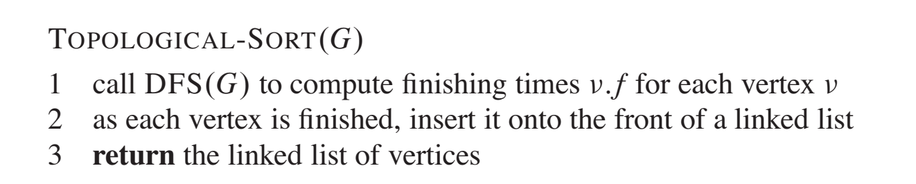
Topological Sort
Can be done using both BFS and DFS
Usually DFS is preferred [self study: link1, link2]

Slide 7
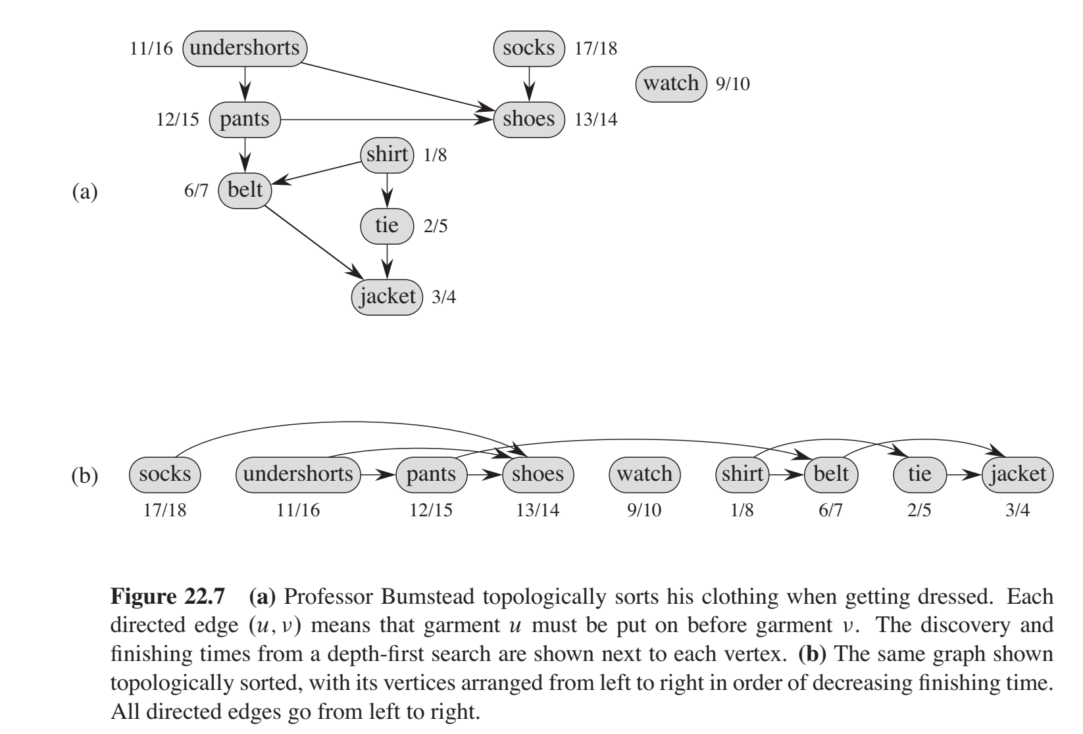
Topological Sort Example

Slide 8
Courses | Prerequisites
Python
OOP | Python
DS | OOP
Algo | DS
Database | OOP
HPDS | Database
Security | Networking
ML | Python, Linear Algebra
Linear Algebra
Graphics | Python, Linear Algebra
Graph | Algo
Networking | Python

Slide 9
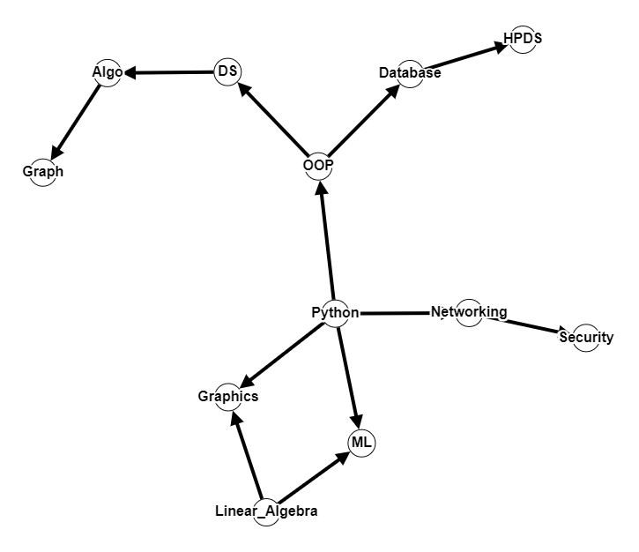
Step 1:
Create Graph

Slide 10
Step 1:
Run DFS
1

Slide 11
2
1

Slide 12
3
2
1

Slide 13
4
3
2
1

Slide 14
4
3
5
2
1

Slide 15
4
3
5/6
2
1
Graph

Slide 16
4/7
3
5/6
2
1
Algo
Graph

Slide 17
4/7
3/8
5/6
2
1
DS
Algo
Graph

Slide 18
4/7
3/8
9
5/6
2
1
DS
Algo
Graph

Slide 19
4/7
3/8
10
9
5/6
2
1
DS
Algo
Graph

Slide 20
4/7
3/8
10/11
9
5/6
2
1
HPDS
DS
Algo
Graph

Slide 21
4/7
3/8
10/11
9/12
5/6
2
1
Database
HPDS
DS
Algo
Graph

Slide 22
4/7
3/8
10/11
9/12
5/6
2/13
OOP
1
Database
HPDS
DS
Algo
Graph

Slide 23
4/7
3/8
10/11
9/12
5/6
2/13
OOP
1
14
Database
15
HPDS
DS
Algo
Graph

Slide 24
4/7
3/8
10/11
9/12
5/6
2/13
Security
OOP
1
14
Database
15/16
HPDS
DS
Algo
Graph

Slide 25
4/7
3/8
10/11
9/12
5/6
Networking
2/13
Security
OOP
1
14/17
Database
15/16
HPDS
DS
Algo
Graph

Slide 26
4/7
3/8
10/11
9/12
5/6
Networking
2/13
Security
OOP
1
14/17
Database
15/16
HPDS
DS
18
Algo
Graph

Slide 27
4/7
3/8
10/11
ML
9/12
5/6
Networking
2/13
Security
OOP
1
14/17
Database
15/16
HPDS
DS
18/19
Algo
Graph

Slide 28
4/7
3/8
10/11
ML
9/12
5/6
Networking
2/13
Security
OOP
1
14/17
Database
15/16
HPDS
20
DS
18/19
Algo
Graph

Slide 29
4/7
Graphics
3/8
10/11
ML
9/12
5/6
Networking
2/13
Security
OOP
1
14/17
Database
15/16
HPDS
20/21
DS
18/19
Algo
Graph

Slide 30
4/7
10/11
Python
3/8
9/12
Graphics
5/6
ML
2/13
Networking
Security
1/22
14/17
OOP
15/16
Database
20/21
HPDS
18/19
DS
Algo
Graph

Slide 31
Linear Algebra
4/7
3/8
10/11
Python
9/12
Graphics
5/6
ML
2/13
Networking
Security
1/22
14/17
15/16
OOP
20/21
Database
HPDS
18/19
DS
Algo
23/24
Graph

Slide 32
Linear Algebra
Acceptable Order of Courses
Python
Graphics
ML
Networking
Security
OOP
Database
HPDS
DS
Algo
Graph

Slide 33
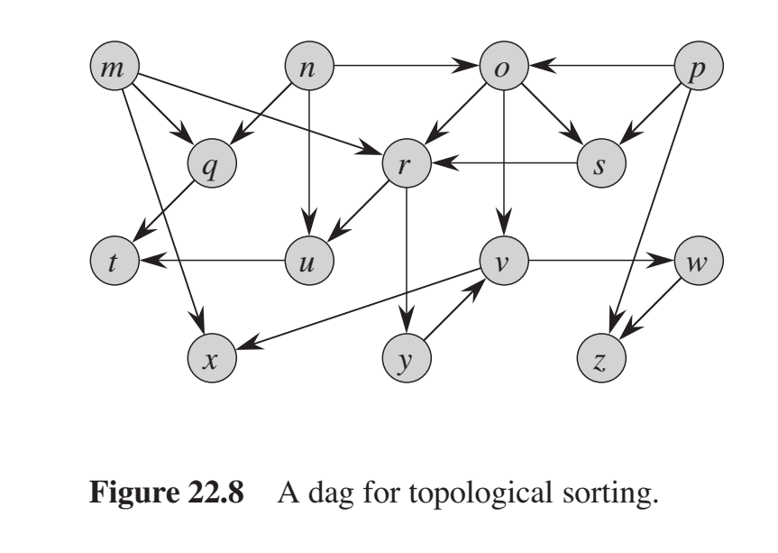
Practice

Slide 34
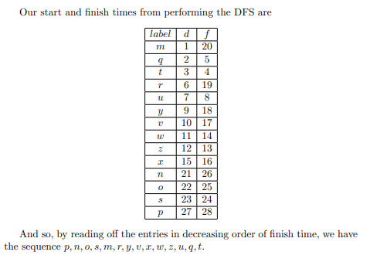
Solution

Slide 35
Code
def dfs(node, graph, visited, sorted_nodes):
visited[node] = True
for neighbor in graph[node]:
if not visited[neighbor]:
dfs(neighbor, graph, visited, sorted_nodes)
sorted_nodes.insert(0, node)
def topological_sort(graph):
num_nodes = len(graph)
visited = [False] * num_nodes
sorted_nodes = []
for node in range(num_nodes):
if not visited[node]:
dfs(node, graph, visited, sorted_nodes)
return sorted_nodes
# Example usage:
if __name__ == "__main__":
# Sample graph represented as an adjacency list
graph = {
0: [1, 2],
1: [3],
2: [3],
3: [4],
4: []
}
result = topological_sort(graph)
print(result) # Output: [0, 2, 1, 3, 4]

Slide 36
Strongly Connected
Components

Slide 37
Strongly Connected Components
We now consider a classic application of depth-first search: decomposing a directed graph into its strongly connected components.
We will see how to do so using two depth-first searches.

Slide 38
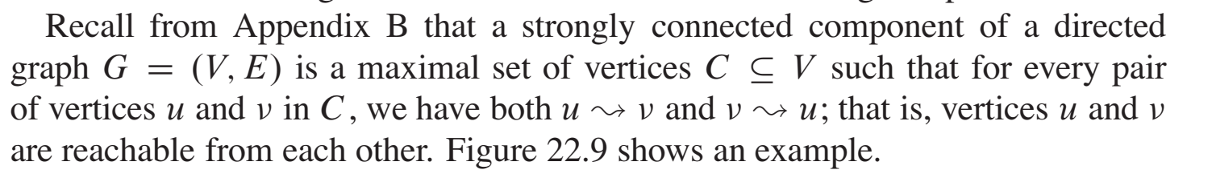
Strongly Connected Components

Slide 39
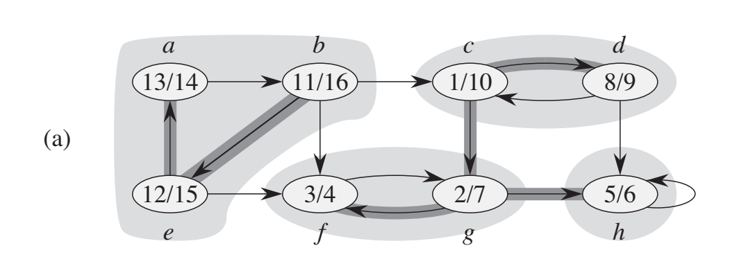
Strongly Connected Components
Each shaded region is a strongly connected component

Slide 40
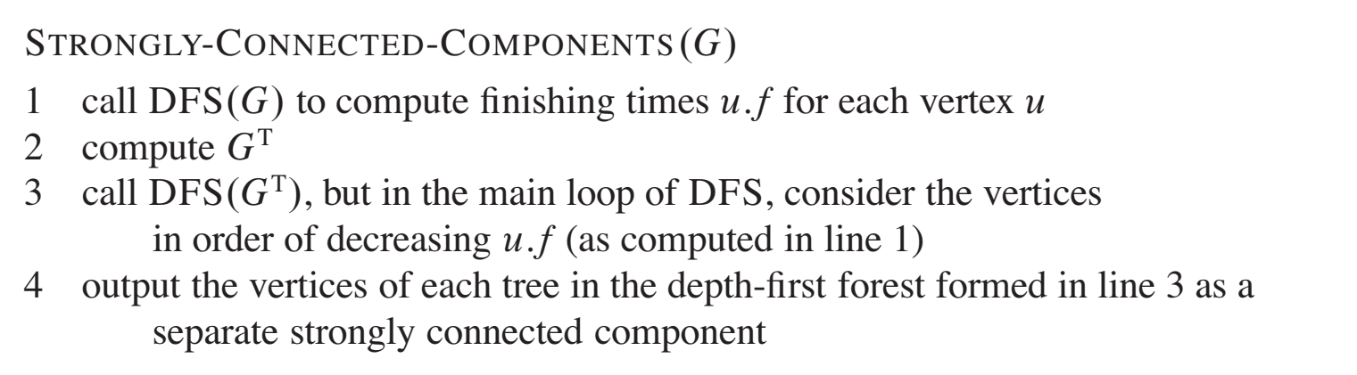
Strongly Connected Components

Slide 41
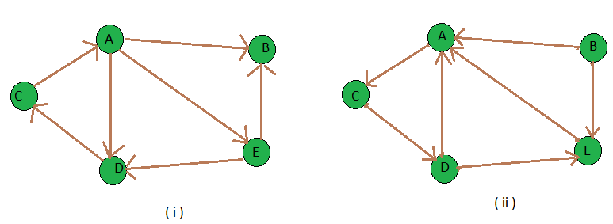
Strongly Connected Components
Transpose of a directed graph G is another directed graph on the same set of vertices with all of the edges reversed

Slide 42
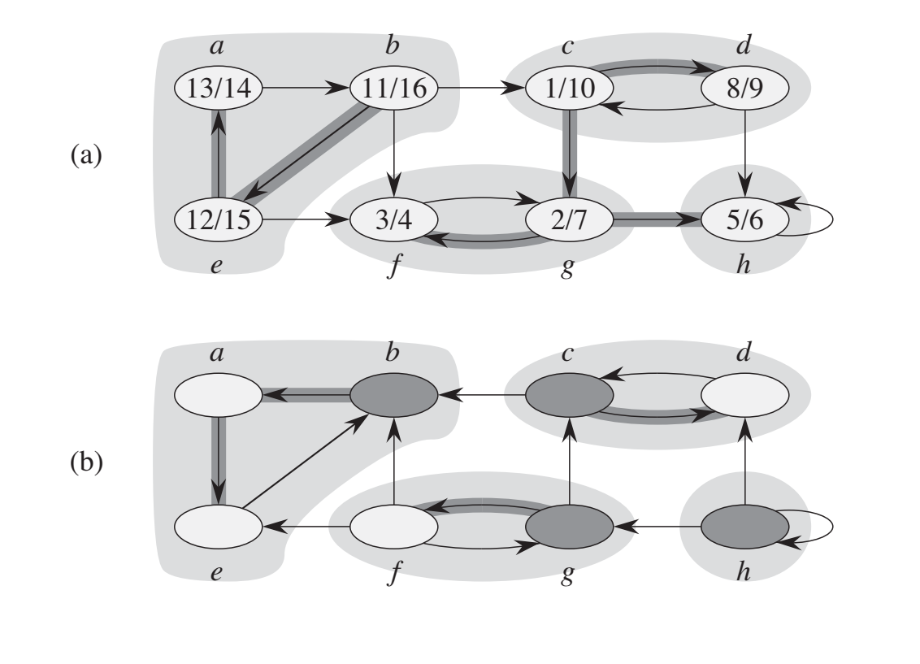
Strongly Connected Components

Slide 43
Strongly Connected Components
b
Decreasing order of finishing time:
16
15
14
10
9
7
6
4
Starting DFS from here →

Slide 44
Strongly Connected Components
ba
Decreasing order of finishing time:
16
15
14
10
9
7
6
4

Slide 45
Strongly Connected Components
bae
Decreasing order of finishing time:
16
15
14
10
9
7
6
4

Slide 46
Strongly Connected Components
bae
Decreasing order of finishing time:
16
15
14
10
9
7
6
4

Slide 47
Strongly Connected Components
bae
Decreasing order of finishing time:
16
15
14
10
9
7
6
4
c

Slide 48
Strongly Connected Components
bae
Decreasing order of finishing time:
16
15
14
10
9
7
6
4
cd

Slide 49
Strongly Connected Components
bae
Decreasing order of finishing time:
16
15
14
10
9
7
6
4
cd

Slide 50
Strongly Connected Components
bae
Decreasing order of finishing time:
16
15
14
10
9
7
6
4
cd

Slide 51
Strongly Connected Components
bae
Decreasing order of finishing time:
16
15
14
10
9
7
6
4
cd
g

Slide 52
Strongly Connected Components
bae
Decreasing order of finishing time:
16
15
14
10
9
7
6
4
cd
gf

Slide 53
Strongly Connected Components
bae
Decreasing order of finishing time:
16
15
14
10
9
7
6
4
cd
gf

Slide 54
Strongly Connected Components
bae
Decreasing order of finishing time:
16
15
14
10
9
7
6
4
cd
gf
h

Slide 55
Strongly Connected Components
bae
Decreasing order of finishing time:
16
15
14
10
9
7
6
4
cd
gf
h

Slide 56
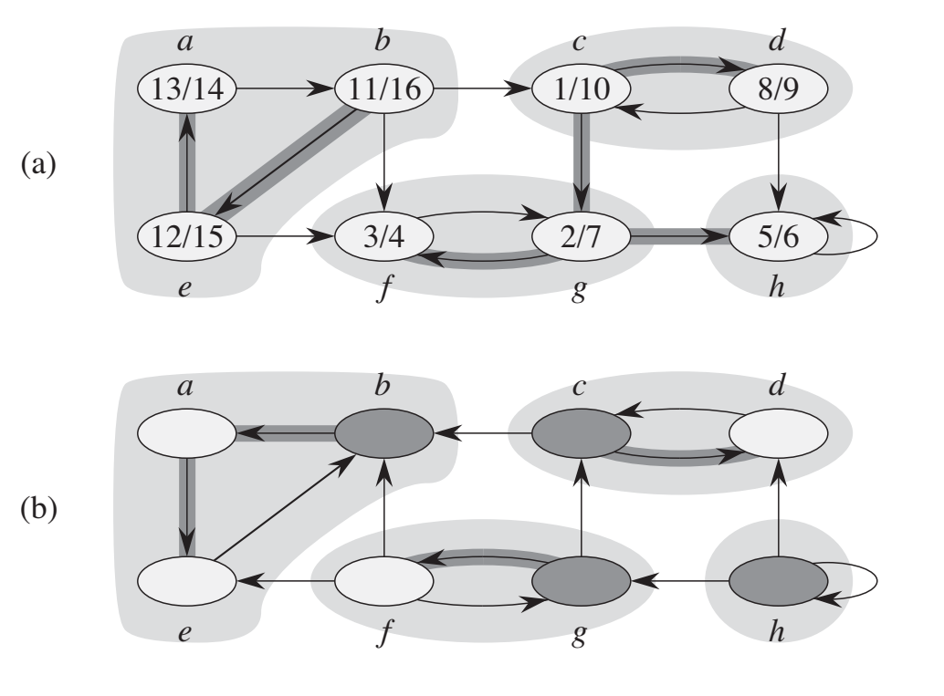
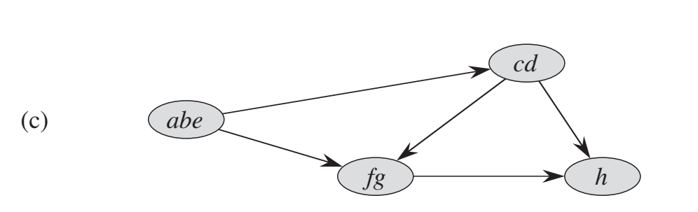
Strongly Connected Components

Slide 57
Code
def dfs_visit(node, graph, visited, stack):
visited[node] = True
for neighbor in graph[node]:
if not visited[neighbor]:
dfs_visit(neighbor, graph, visited, stack)
stack.append(node)
def dfs_scc(node, graph, visited, scc):
visited[node] = True
scc.append(node)
for neighbor in graph[node]:
if not visited[neighbor]:
dfs_scc(neighbor, graph, visited, scc)
def transpose_graph(graph):
transposed_graph = {node: [] for node in graph}
for node in graph:
for neighbor in graph[node]:
transposed_graph[neighbor].append(node)
return transposed_graph
def strongly_connected_components(graph):
num_nodes = len(graph)
visited = [False] * num_nodes
stack = []
for node in range(num_nodes):
if not visited[node]:
dfs_visit(node, graph, visited, stack)
transposed_graph = transpose_graph(graph)
visited = [False] * num_nodes
strongly_connected_components = []
while stack:
node = stack.pop()
if not visited[node]:
scc = []
dfs_scc(node, transposed_graph, visited, scc)
strongly_connected_components.append(scc)
return strongly_connected_components
The stack is used to store the nodes in reverse order of their finishing time

Slide 58
# Example usage:
if __name__ == "__main__":
# Sample graph represented as an adjacency list
graph = {
0: [1],
1: [2],
2: [0, 3],
3: [4],
4: [3]
}
result = strongly_connected_components(graph)
print(result) # Output: [[4, 3], [2, 1, 0]]

